Slide 1
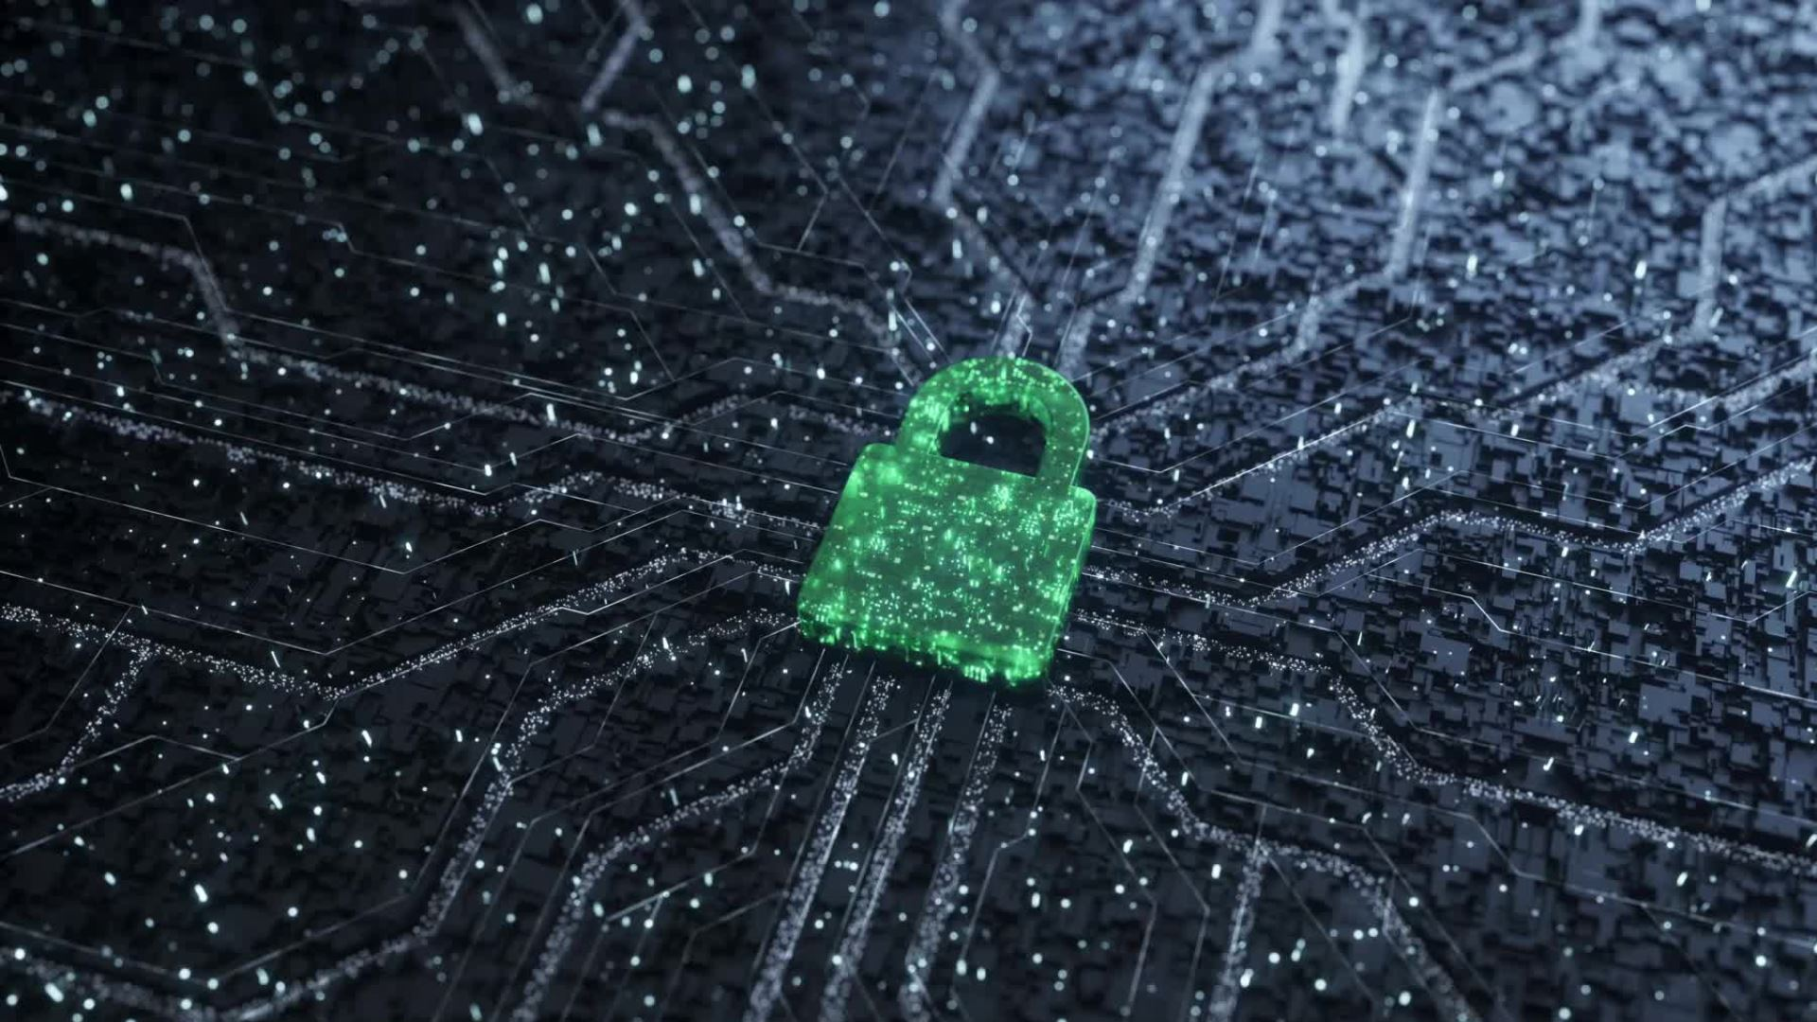
Overview of Security

Slide 2
CO3:Explore system security concepts

Slide 3
Introduction
Security goals
Security services and mechanisms
Security models, Threats
Types of attacks
CIA Triad: Confidentiality, Integrity, and Availability

Slide 4
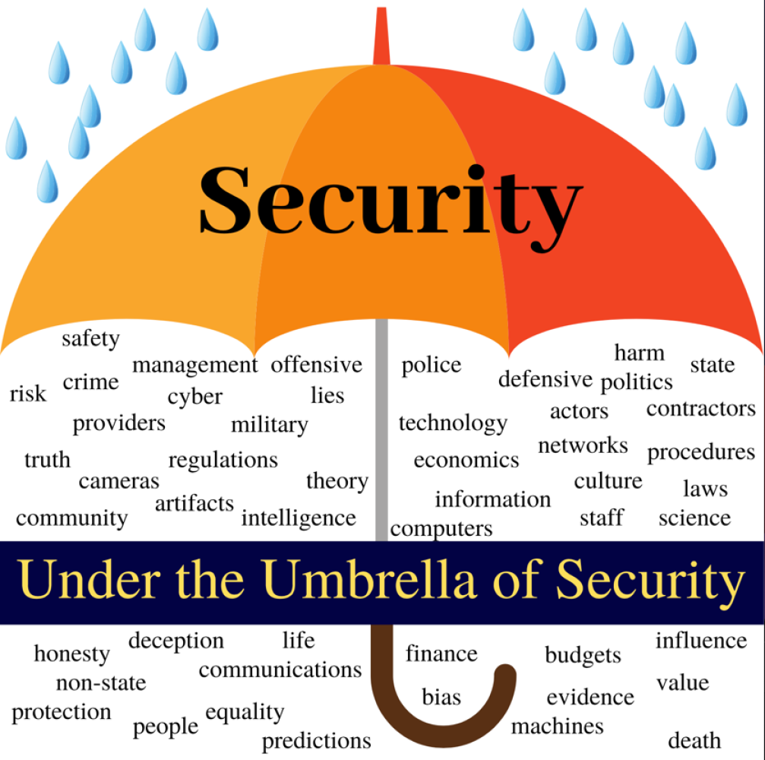

Slide 5
Introduction
Security of Data and Information is crucial for companies and individuals.

Slide 6
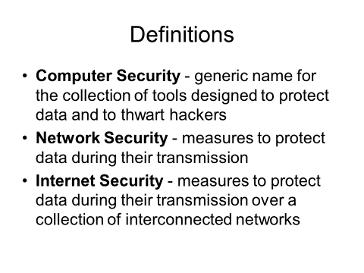

Slide 7
Information security (sometimes referred to as InfoSec) covers the tools and processes that organizations use to protect information.
Includes policy settings that prevent unauthorized people from accessing business or personal information.
InfoSec is a growing and evolving field that covers a wide range of fields, from network and infrastructure security to testing and auditing.

Slide 8
Information security protects sensitive information from unauthorized activities, including inspection, modification, recording, and any disruption or destruction.
The goal is to ensure the safety and privacy of critical data such as customer account details, financial data or intellectual property.

Slide 9
The consequences of security incidents include theft of private information, data tampering, and data deletion. Attacks can disrupt work processes and damage a company’s reputation, and also have a tangible cost.
Organizations must allocate funds for security and ensure that they are ready to detect, respond to, and proactively prevent, attacks such as phishing, malware, viruses, malicious insiders, and ransomware.

Slide 10
Information security differs from cybersecurity in both scope and purpose. The two terms are often used interchangeably, but more accurately, cybersecurity is a subcategory of information security. Information security is a broad field that covers many areas such as physical security, endpoint security, data encryption, and network security. It is also closely related to information assurance, which protects information from threats such as natural disasters and server failures.

Slide 11
Cybersecurity primarily addresses technology-related threats, with practices and tools that can prevent or mitigate them.
Another related category is data security, which focuses on protecting an organization’s data from accidental or malicious exposure to unauthorized parties.

Slide 12
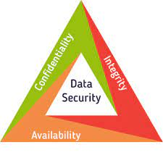
Security goals

Slide 13
Security
need systematic way to define requirements
consider three aspects of information security(OSI security architecture):
–security attack
–security mechanism
–security service

Slide 14
Security services
The processing or communication service that is provide by system to give specific kind of protection to system services.
System services, implement security policies and implemented by security mechanism.

Slide 15
Security services
–is something that enhances the security of the data processing systems and the information transfers of an organization
–intended to counter security attacks
–make use of one or more security mechanisms to provide the service
–replicate functions normally associated with physical documents
•eg. have signatures, dates; need protection from disclosure, tampering, or destruction; be notarized or witnessed; be recorded or licensed

Slide 16
Security services
Authentication
Peer entity Authentication
Data origin Authentication
Access Control
Data confidentiality
Data Integrity
Non repudiation

Slide 17
Peer Entity Authentication: Used in association with a logical connection to provide confidence in the identity of the entities connected.
Data-Origin Authentication: In a connectionless transfer, provides assurance that the source of received data is as claimed.

Slide 18
Data Confidentiality: Protects data from unauthorized disclosure.
Access Control: The prevention of unauthorized use of a resource (i.e., this service controls who can have access to a resource, under what conditions access can occur, and what those accessing the resource are allowed to do).

Slide 19
Data Integrity: The assurance that data received are exactly as sent by an authorized entity (i.e., contain no modification, insertion, deletion, or replay).
Non-repudiation: Protects against denial by one of the entities involved in a communication of having participated in all or part of the communication.
Proof of Origin: Proof that the message was sent by the specified party.
Proof of Delivery: Proof that the message was received by the specified party.

Slide 20
Security Mechanism
•a mechanism that is designed to detect, prevent, or recover from a security attack
•no single mechanism that will support all functions required
however one particular element underlies many of the security mechanisms in use: cryptographic techniques

Slide 21
Specific security mechanism
Encipherment
Digital signature
Access Control
Data Integrity
Authentication Exchange
Traffic padding
Routing control
Notarization

Slide 22
1. Encipherment:
This is hiding or covering of data which provides confidentiality. It is also used to complement other mechanisms to provide other services. Cryptography and Steganography are used for enciphering

Slide 23
2. Digital Integrity:
The data integrity mechanism appends to the data a short check value that has been created by a specific process from the data itself. Data integrity is preserved by comparing check value received to the check value generated.

Slide 24
3. Digital Signature:
A digital signature is a means by which the sender can electronically sign the data and the receiver can electronically verify the signature. Public and private keys can be used.

Slide 25
4. Authentication Exchange:
In this two entities exchange some messages to prove their identity to each other.

Slide 26
5. Traffic Padding:
Traffic padding means inserting some bogus data into the data traffic to thwart the adversary’s attempt to use the traffic analysis.

Slide 27
6. Routing Control:
Routing control means selecting and continuously changing different available routes between sender and receiver to prevent the opponent from eavesdropping on a particular route.

Slide 28
7. Notarization:
Notarization means selecting a third trusted party to control the communication between two entities. The receiver can involve a trusted third party to store the sender request in order to prevent the sender from later denying that she has made a request.

Slide 29
8. Access Control:
Access control used methods to prove that a user has access right to the data or resources owned by a system. Examples of proofs are passwords and PINs.

Slide 30
Security Threats
•any action that compromises the security of information owned by an organization
•information security is about how to prevent attacks, or failing that, to detect attacks on information-based systems
•have a wide range of attacks
•can focus of generic types of attacks
•note: often threat & attack mean same

Slide 31
•ITU-T X.800 Security Architecture for OSI
•defines a systematic way of defining and providing security requirements
•for us it provides a useful, if abstract, overview of concepts we will study

Slide 32
Security Services
Confidentiality (privacy)
Authentication (who created or sent the data)
Integrity (has not been altered)
Non-repudiation (the order is final)
Access control (prevent misuse of resources)
Availability (permanence, non-erasure)²Denial of
Service Attacks
Virus that deletes files

Slide 33
Security Services
•X.800 defines it as: a service provided by a protocol layer of communicating open systems, which ensures adequate security of the systems or of data transfers
•RFC 2828 defines it as: a processing or communication service provided by a system to give a specific kind of protection to system resources
•X.800 defines it in 5 major categories

Slide 34
Security Services (X.800)
•Authentication - assurance that the communicating entity is the one claimed
•Access Control - prevention of the unauthorized use of a resource
•Data Confidentiality –protection of data from unauthorized disclosure
•Data Integrity - assurance that data received is as sent by an authorized entity
•Non-Repudiation - protection against denial by one of the parties in a communication

Slide 35
Security Mechanisms (X.800)
•specific security mechanisms:
–encipherment, digital signatures, access controls, data integrity, authentication exchange, traffic padding, routing control, notarization
•pervasive security mechanisms:
–trusted functionality, security labels, event detection, security audit trails, security recovery

Slide 36
Pervasive security mechanism
Trusted functionality
Security Label
Event detection
Security Audit Trail
Security Recovery

Slide 37
Pervasive security refers to the practice of embedding security measures and protocols throughout an entire organization's infrastructure, rather than just at specific points or layers.
Pervasive security mechanisms, not specific to particular services

Slide 38
Trusted Functionality − The process that which is recognized to be correct regarding some criteria such as established by a security policy.
Security Label − This is an approach of marking of a constrained to a resource (which can be a data unit) that label or designates the security nature of that resource.
.

Slide 39
Event Detection − Detection of security-relevant events including forgery, denial of sending or receiving of information, modification of information etc.
Security Audit Trail − It supports a valuable security mechanism, as possibly they allow detection and analysis of breaches of security by allowing a subsequent security audit.

Slide 40
A security audit is an independent report and investigation of system data and events in order to test for sufficiency of system controls, to provide compliance with established policy and operational processes, to help in loss assessment and to approve some indicated changes in controls, policy and processes.
Security Recovery − This negotiate with requests from mechanisms, including event managing and executive functions, and takes recovery conduct

Slide 41
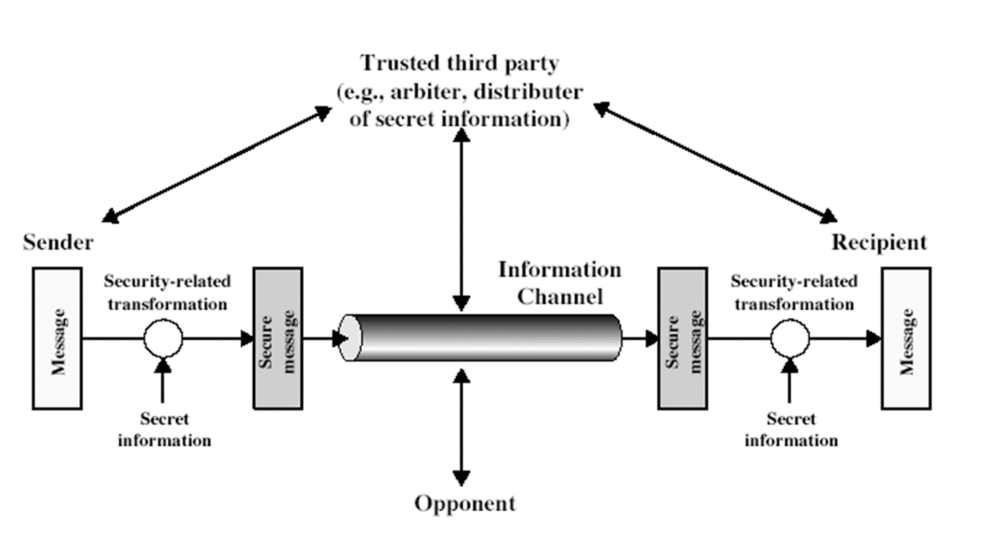
Model for Network Security

Slide 42
Model for Network Security
information flowing over an insecure communications channel, in the presence of possible opponents.
an appropriate security transform (encryption algorithm) can be used, with suitable keys, possibly negotiated using the presence of a trusted third party.

Slide 43
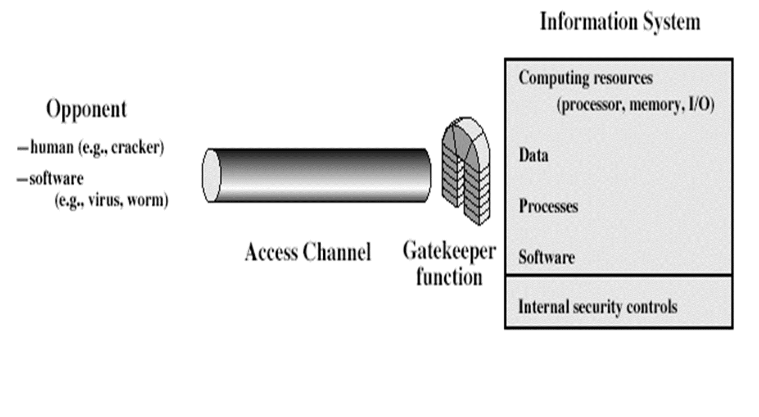
Model for Network Access Security

Slide 44
•using this model requires us to:
–design a suitable algorithm for the security transformation
–generate the secret information (keys) used by the algorithm
–develop methods to distribute and share the secret information
–specify a protocol enabling the principals to use the transformation and secret information for a security service

Slide 45
concerned with controlled access to information or resources on a computer system, in the presence of possible opponents. Here appropriate controls are needed on the access and within the system, to provide suitable security. Some cryptographic techniques are useful here also.

Slide 46
•using this model requires us to:
–select appropriate gatekeeper functions to identify users
–implement security controls to ensure only authorised users access designated information or resources
•trusted computer systems can be used to implement this model

Slide 47
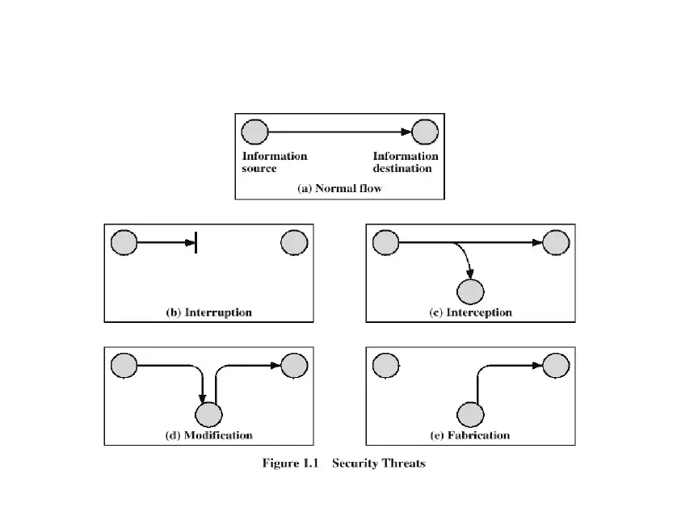

Slide 48
Interruption:
An asset of the system is destroyed or becomes unavailable or unusable.
This is an attack on availability
Examples:
Destroying some H/W (disk or wire).
Disabling file system.
Swamping a computer with jobs or communication link with packets.

Slide 49
Interception:
An unauthorized party gains access to an asset.
This is an attack on confidentiality.
Examples: Wiretapping to capture data in a\network.
Illicitly copying data or programs.

Slide 50
Modification:
An unauthorized party gains access and tampers an asset.
This is an attack on integrity. Examples:
Changing data files.
Altering a program.
Altering the contents of a message.

Slide 51
Fabrication:
An unauthorized party inserts a counterfeit object into the system.
This is an attack on authenticity.
Examples:>
Insertion of records in data files.
Insertion of spurious messages in a network. (message replay).

Slide 52
Security services | Security mechanism
Data confidentiality | Encipherment, Routing control
Data integrity | Encipherment, Data integrity, Digital signature
Authentication | Authentication exchanges, Digital signature, Encipherment
Non repudiation | Data integrity, Digital signature, Notarization
Access control | Access control mechanism

Slide 53
Types of attacks
•passive attacks - eavesdropping on, or monitoring of, transmissions to:
–obtain message contents, or
–monitor traffic flows
•active attacks – modification of data stream to:
–masquerade of one entity as some other
–replay previous messages
–modify messages in transit
–denial of service

Slide 54
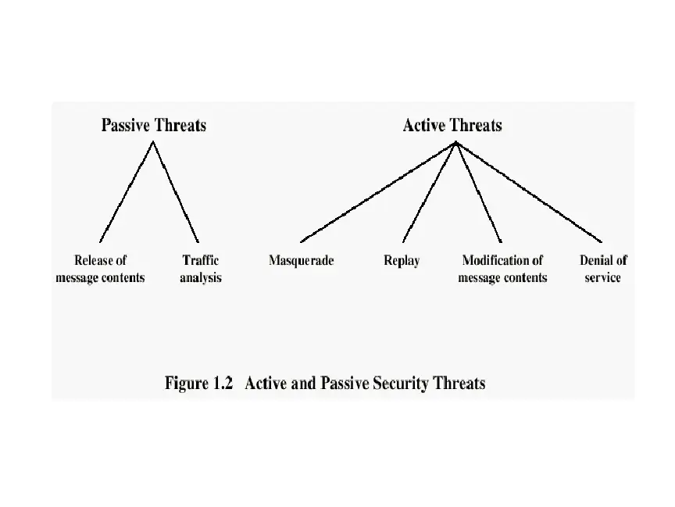

Slide 55
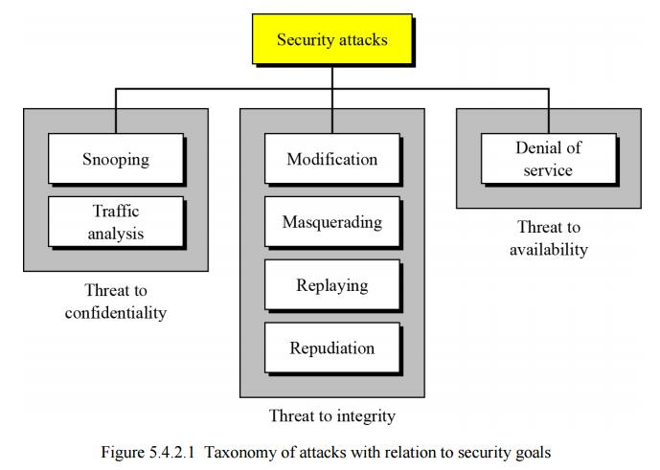

Slide 56
Passive
Release of a message contents:
Contents of a message are read.
A message may be carrying sensitive or confidential data.
Traffic analysis:
An intruder makes inferences by observing message patterns.
Can be done even if messages are encrypted. Inferences: location and identity of hosts.

Slide 57
Active
Masquerade: An entity pretends to be some other entity.
Example: An entity captures an authentication sequence and replays it later to impersonate the original entity.
Replay: Involves capture of a data unit and its retransmission to produce an unauthorized effect.

Slide 58
Repudiation:
This type of attack is performed by on of the two parties in communication, sender or receiver.
The sender of message might later deny that he has sent the message ,the receiver of message might deny that he has received message.

Slide 59
Modification of messages:
A portion of a legitimate message has been altered to produce an undesirable effect.
Denial of service:
Inhibits normal use of computer and communications resources.
Flooding of computer network.>Swamping of CPU or a server .Attacker might send so many bogus request to server that the server crashes because of heavy load. Attacker might intercept and delete server's response to client ,making client believe that server is not responding.

Slide 60
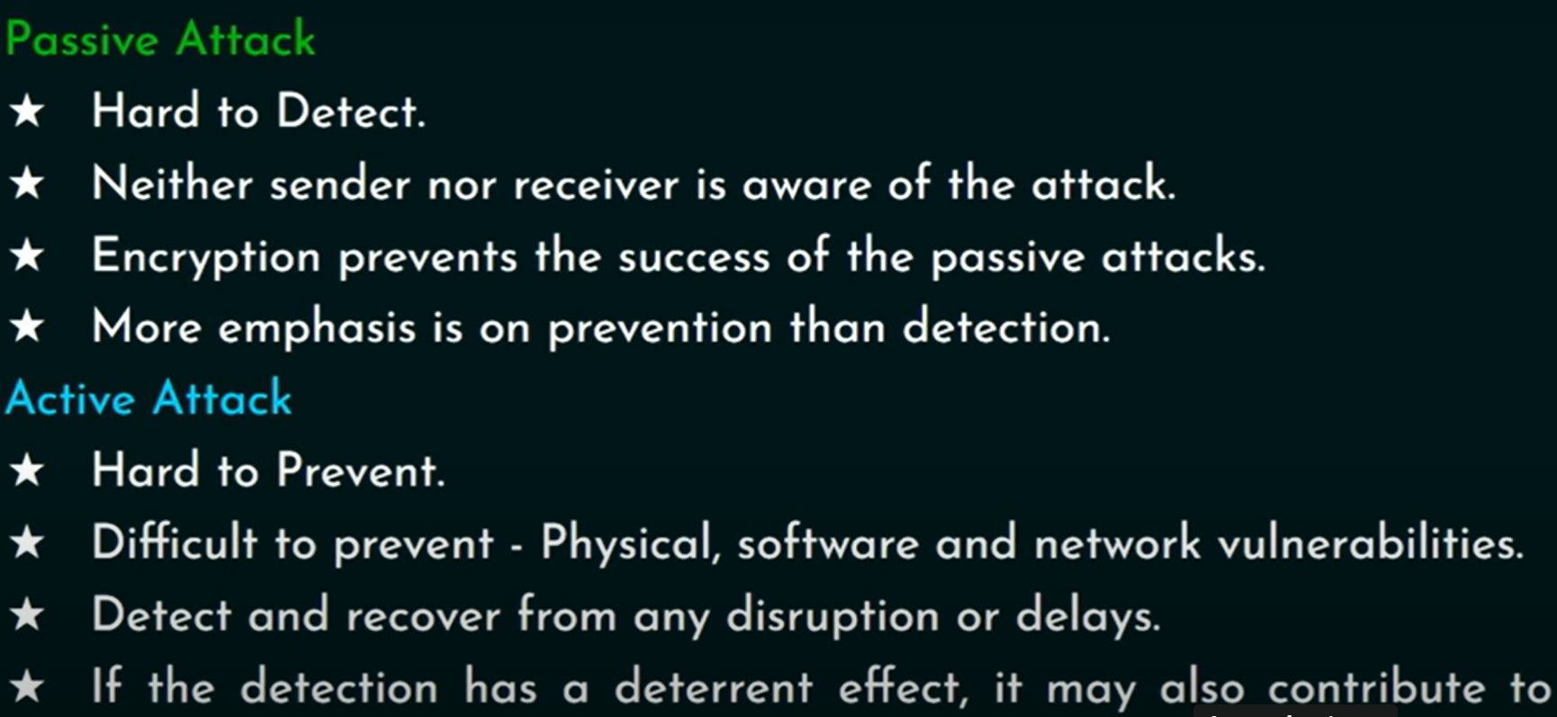

Slide 61
CIA Triad: Confidentiality, Integrity, and Availability
The CIA security triad is comprised of three functions:
Confidentiality. A system’s ability to ensure that only the correct, authorized user/system/resource can view, access, change, or otherwise use data.
Integrity. A system’s ability to ensure that the system and information is accurate and correct.
Availability. A system’s ability to ensure that systems, information, and services are available the vast majority of time.

Slide 62
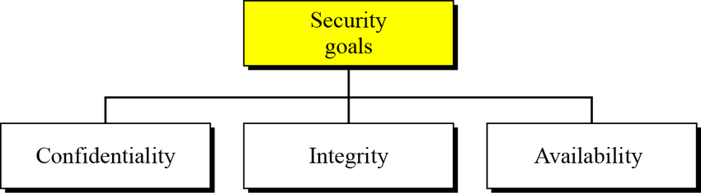

Slide 63
Confidentiality
Data is only accessible to genuine and authorized users
Prevent unauthorized access to the data, exploiting the information

Slide 64
Methods
Encrypt the raw data using encryption techniques.
Use biometric-based access control to authorize genuine users to access the data.
Multi-Factor Authentication can be used, which reduces the chances of data being exploited.
Implement firewalls and intrusion detection systems to ensure that no third party can access the data without proper clearance.

Slide 65
Tools for confidentiality
Encryption : technique to convert the data into ciphertext using mathematical methods and a password or key.
Access Control: rules and procedures to limit who can access the system and resources.
users need to produce their credentials to access the system. credentials can be in any form ranging from id card to biometric information.
non-transferable credentials are the most secure ones.

Slide 66
Authentication: confirmation process of the user's credentials to provide access to the system and resources. Authentication can be done using passwords or fingerprints etc.
Authorization: used to determine whether the user is allowed to access a particular level or not and based on that, the user is granted or refused access.
process is preceded by Authentication. The authorization is checked only for authenticated users.

Slide 67
Physical Security: describes the methods designed to handle the physical threats to the system like theft, vandalism, fire, etc.
keeps the system robust during hardware failures as well.

Slide 68
Integrity
Ensuring that the data is in its original form and not altered during the transmission and reaches the end-user in its correct condition.
provides safeguards from the modification of data by unauthorized users and determines that the source of information is legit.

Slide 69
Methods to ensure integrity
Back up the data and resources to ensure that data is safe during system failures.
Set up a version control system to store the logs so that any modifications in the system can be tracked and analyzed whenever needed.
Use the access control system to avoid any unauthorized modification of the data.
Make sure that no user can accidentally or intentionally tamper the company data.

Slide 70
Tools to maintain the system's integrity
Backups: a duplicate archive of the original data and is done periodically to ensure that the data is safe even in case of loss of the actual information or if the files are destroyed. It copies the original data and stores it for emergencies or statistical or historical uses.

Slide 71
Checksums: numerical value that is mapped to the contents of the files.
This numerical value is then compared, before and after the transmission, to ensure that the data stays the same on both sides.
designed so that even a tiny change in the file's contents will change its numerical value and determine any data changes.

Slide 72
Data Correcting Codes: It is a method to handle the errors during a failed or corrupted data transfer. It automatically corrects any changes that happen in the data during transmission.

Slide 73
Availability
Helps deliver the data as and when authorized users require it without errors like denial of service.
The data needs to be constantly available for access.
It is the guarantee of the reliability of the data.

Slide 74
Let's consider the case of banks where users frequently access their account information and do transactions. If that bank's system gets crashed, the users will not be able to do necessary transactions like paying hospital bills, etc. So it becomes imperative that the data remains constantly available to the users. .

Slide 75
Methods used to ensure the availability
Maintain backup servers which can be used in case of system failures.
Install firewalls to ensure that the system doesn't get compromised.
Backups should be placed in geographically isolated places to avoid damages due to any disaster in a particular location.

Slide 76
Tools required to maintain availability
Physical protection refers to safeguarding information to avoid theft or fire, etc.
Ensures that the data is housed in a safe place.
Computational redundancies:
Makes the system tolerant to unwanted modifications or accidental faults.
Protects the storage devices that contain data by making a fallback system in case of failures

Slide 77
Methods of Defense
Encryption
Software Controls (access limitations in a data base, in operating each user from other users)
Hardware Controls (smartcard)
Policies (frequent changes of passwords)
Physical Controls

